Slide 1
nodeMCU 3
WiFi 3 + mqtt

Slide 2
HelloServerSecure 예제 (1)
#include <ESP8266WiFi.h>
#include <WiFiClient.h>
#include <ESP8266WebServerSecure.h>
#include <ESP8266mDNS.h>
#ifndef STASSID
#define STASSID “********"
#define STAPSK “*********"
#endif
const char* ssid = STASSID;
const char* password = STAPSK;
ESP8266WebServerSecure server(443);

Slide 3
HelloServerSecure 예제 (2)
// And so is the key. These could also be in DRAM
static const uint8_t rsakey[] PROGMEM = {
0x30, 0x82, 0x01, 0x3a, 0x02, 0x01, 0x00, 0x02, 0x41, 0x00, 0xc6, 0x72,
0x6c, 0x12, 0xe1, 0x20, 0x4d, 0x10, 0x0c, 0xf7, 0x3a, 0x2a, 0x5a, 0x49,
0xe2, 0x2d, 0xc9, 0x7a, 0x63, 0x1d, 0xef, 0xc6, 0xbb, 0xa3, 0xd6, 0x6f,
0x59, 0xcb, 0xd5, 0xf6, 0xbe, 0x34, 0x83, 0x33, 0x50, 0x80, 0xec, 0x49,
0x63, 0xbf, 0xee, 0x59, 0x94, 0x67, 0x8b, 0x8d, 0x81, 0x85, 0x23, 0x24,
0x06, 0x52, 0x76, 0x55, 0x9d, 0x18, 0x09, 0xb3, 0x3c, 0x10, 0x40, 0x05,
0x01, 0xf3, 0x02, 0x03, 0x01, 0x00, 0x01, 0x02, 0x40, 0x35, 0x0b, 0x74,
0xd3, 0xff, 0x15, 0x51, 0x44, 0x0f, 0x13, 0x2e, 0x9b, 0x0f, 0x93, 0x5c,
0x3f, 0xfc, 0xf1, 0x17, 0xf9, 0x72, 0x94, 0x5e, 0xa7, 0xc6, 0xb3, 0xf0,
0xfe, 0xc9, 0x6c, 0xb1, 0x1e, 0x83, 0xb3, 0xc6, 0x45, 0x3a, 0x25, 0x60,
0x7c, 0x3d, 0x92, 0x7d, 0x53, 0xec, 0x49, 0x8d, 0xb5, 0x45, 0x10, 0x99,
0x9b, 0xc6, 0x22, 0x3a, 0x68, 0xc7, 0x13, 0x4e, 0xb6, 0x04, 0x61, 0x21,
0x01, 0x02, 0x21, 0x00, 0xea, 0x8c, 0x21, 0xd4, 0x7f, 0x3f, 0xb6, 0x91,
0xfa, 0xf8, 0xb9, 0x2d, 0xcb, 0x36, 0x36, 0x02, 0x5f, 0xf0, 0x0c, 0x6e,
0x87, 0xaa, 0x5c, 0x14, 0xf6, 0x56, 0x8e, 0x12, 0x92, 0x25, 0xde, 0xb3,
0x02, 0x21, 0x00, 0xd8, 0x99, 0x01, 0xf1, 0x04, 0x0b, 0x98, 0xa3, 0x71,
0x56, 0x1d, 0xea, 0x6f, 0x45, 0xd1, 0x36, 0x70, 0x76, 0x8b, 0xab, 0x69,
0x30, 0x58, 0x9c, 0xe0, 0x45, 0x97, 0xe7, 0xb6, 0xb5, 0xef, 0xc1, 0x02,
0x21, 0x00, 0xa2, 0x01, 0x06, 0xc0, 0xf2, 0xdf, 0xbc, 0x28, 0x1a, 0xb4,
0xbf, 0x9b, 0x5c, 0xd8, 0x65, 0xf7, 0xbf, 0xf2, 0x5b, 0x73, 0xe0, 0xeb,
0x0f, 0xcd, 0x3e, 0xd5, 0x4c, 0x2e, 0x91, 0x99, 0xec, 0xb7, 0x02, 0x20,
0x4b, 0x9d, 0x46, 0xd7, 0x3c, 0x01, 0x4c, 0x5d, 0x2a, 0xb0, 0xd4, 0xaa,
0xc6, 0x03, 0xca, 0xa0, 0xc5, 0xac, 0x2c, 0xe0, 0x3f, 0x4d, 0x98, 0x71,
0xd3, 0xbd, 0x97, 0xe5, 0x55, 0x9c, 0xb8, 0x41, 0x02, 0x20, 0x02, 0x42,
0x9f, 0xd1, 0x06, 0x35, 0x3b, 0x42, 0xf5, 0x64, 0xaf, 0x6d, 0xbf, 0xcd,
0x2c, 0x3a, 0xcd, 0x0a, 0x9a, 0x4d, 0x7c, 0xad, 0x29, 0xd6, 0x36, 0x57,
0xd5, 0xdf, 0x34, 0xeb, 0x26, 0x03
};
// The certificate is stored in PMEM
static const uint8_t x509[] PROGMEM = {
0x30, 0x82, 0x01, 0x3d, 0x30, 0x81, 0xe8, 0x02, 0x09, 0x00, 0xfe, 0x56,
0x46, 0xf2, 0x78, 0xc6, 0x51, 0x17, 0x30, 0x0d, 0x06, 0x09, 0x2a, 0x86,
0x48, 0x86, 0xf7, 0x0d, 0x01, 0x01, 0x0b, 0x05, 0x00, 0x30, 0x26, 0x31,
0x10, 0x30, 0x0e, 0x06, 0x03, 0x55, 0x04, 0x0a, 0x0c, 0x07, 0x45, 0x53,
0x50, 0x38, 0x32, 0x36, 0x36, 0x31, 0x12, 0x30, 0x10, 0x06, 0x03, 0x55,
0x04, 0x03, 0x0c, 0x09, 0x31, 0x32, 0x37, 0x2e, 0x30, 0x2e, 0x30, 0x2e,
0x31, 0x30, 0x1e, 0x17, 0x0d, 0x31, 0x37, 0x30, 0x33, 0x31, 0x38, 0x31,
0x34, 0x34, 0x39, 0x31, 0x38, 0x5a, 0x17, 0x0d, 0x33, 0x30, 0x31, 0x31,
0x32, 0x35, 0x31, 0x34, 0x34, 0x39, 0x31, 0x38, 0x5a, 0x30, 0x26, 0x31,
0x10, 0x30, 0x0e, 0x06, 0x03, 0x55, 0x04, 0x0a, 0x0c, 0x07, 0x45, 0x53,
0x50, 0x38, 0x32, 0x36, 0x36, 0x31, 0x12, 0x30, 0x10, 0x06, 0x03, 0x55,
0x04, 0x03, 0x0c, 0x09, 0x31, 0x32, 0x37, 0x2e, 0x30, 0x2e, 0x30, 0x2e,
0x31, 0x30, 0x5c, 0x30, 0x0d, 0x06, 0x09, 0x2a, 0x86, 0x48, 0x86, 0xf7,
0x0d, 0x01, 0x01, 0x01, 0x05, 0x00, 0x03, 0x4b, 0x00, 0x30, 0x48, 0x02,
0x41, 0x00, 0xc6, 0x72, 0x6c, 0x12, 0xe1, 0x20, 0x4d, 0x10, 0x0c, 0xf7,
0x3a, 0x2a, 0x5a, 0x49, 0xe2, 0x2d, 0xc9, 0x7a, 0x63, 0x1d, 0xef, 0xc6,
0xbb, 0xa3, 0xd6, 0x6f, 0x59, 0xcb, 0xd5, 0xf6, 0xbe, 0x34, 0x83, 0x33,
0x50, 0x80, 0xec, 0x49, 0x63, 0xbf, 0xee, 0x59, 0x94, 0x67, 0x8b, 0x8d,
0x81, 0x85, 0x23, 0x24, 0x06, 0x52, 0x76, 0x55, 0x9d, 0x18, 0x09, 0xb3,
0x3c, 0x10, 0x40, 0x05, 0x01, 0xf3, 0x02, 0x03, 0x01, 0x00, 0x01, 0x30,
0x0d, 0x06, 0x09, 0x2a, 0x86, 0x48, 0x86, 0xf7, 0x0d, 0x01, 0x01, 0x0b,
0x05, 0x00, 0x03, 0x41, 0x00, 0x69, 0xdc, 0x6c, 0x9b, 0xa7, 0x62, 0x57,
0x7e, 0x03, 0x01, 0x45, 0xad, 0x9a, 0x83, 0x90, 0x3a, 0xe7, 0xdf, 0xe8,
0x8f, 0x46, 0x00, 0xd3, 0x5f, 0x2b, 0x0a, 0xde, 0x92, 0x1b, 0xc5, 0x04,
0xc5, 0xc0, 0x76, 0xf4, 0xf6, 0x08, 0x36, 0x97, 0x27, 0x82, 0xf1, 0x60,
0x76, 0xc2, 0xcd, 0x67, 0x6c, 0x4b, 0x6c, 0xca, 0xfd, 0x97, 0xfd, 0x33,
0x9e, 0x12, 0x67, 0x6b, 0x98, 0x7e, 0xd5, 0x80, 0x8f
};

Slide 4
HelloServerSecure 예제 (3)
const int led = 13;
void handleRoot() {
digitalWrite(led, 1);
server.send(200, "text/plain", "Hello from esp8266 over HTTPS!");
digitalWrite(led, 0);
}
void handleNotFound() {
digitalWrite(led, 1);
String message = "File Not Found\n\n";
message += "URI: ";
message += server.uri();
message += "\nMethod: ";
message += (server.method() == HTTP_GET) ? "GET" : "POST";
message += "\nArguments: ";
message += server.args();
message += "\n";
for (uint8_t i = 0; i < server.args(); i++) {
message += " " + server.argName(i) + ": " + server.arg(i) + "\n";
}
server.send(404, "text/plain", message);
digitalWrite(led, 0);
}
void setup(void) {
pinMode(led, OUTPUT);
digitalWrite(led, 0);
Serial.begin(115200);
WiFi.begin(ssid, password);
Serial.println("");
// Wait for connection
while (WiFi.status() != WL_CONNECTED) {
delay(500);
Serial.print(".");
}
Serial.println("");
Serial.print("Connected to ");
Serial.println(ssid);
Serial.print("IP address: ");
Serial.println(WiFi.localIP());
if (MDNS.begin("esp8266")) {
Serial.println("MDNS responder started");
}

Slide 5
HelloServerSecure 예제 (4)
server.setServerKeyAndCert_P(rsakey, sizeof(rsakey), x509, sizeof(x509));
server.on("/", handleRoot);
server.on("/inline", []() {
server.send(200, "text/plain", "this works as well");
});
server.onNotFound(handleNotFound);
server.begin();
Serial.println("HTTPS server started");
}
void loop(void) {
server.handleClient();
MDNS.update();
}

Slide 6
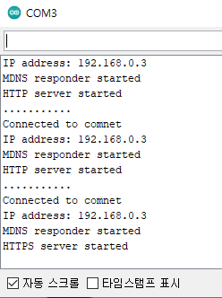
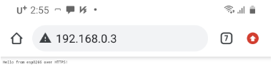
실행결과

Slide 7
AdvancedWebServer 예제 (1)
#include <ESP8266WiFi.h>
#include <WiFiClient.h>
#include <ESP8266WebServer.h>
#include <ESP8266mDNS.h>
#ifndef STASSID
#define STASSID "your-ssid"
#define STAPSK "your-password"
#endif
const char *ssid = STASSID;
const char *password = STAPSK;
ESP8266WebServer server(80);
void handleNotFound() {
digitalWrite(led, 1);
String message = "File Not Found\n\n";
message += "URI: ";
message += server.uri();
message += "\nMethod: ";
message += (server.method() == HTTP_GET) ? "GET" : "POST";
message += "\nArguments: ";
message += server.args();
message += "\n";
for (uint8_t i = 0; i < server.args(); i++) {
message += " " + server.argName(i) + ": " + server.arg(i) + "\n";
}
server.send(404, "text/plain", message);
digitalWrite(led, 0);
}

Slide 8
AdvancedWebServer 예제 (2) - handleRoot()
const int led = 13;
void handleRoot() {
digitalWrite(led, 1);
char temp[400];
int sec = millis() / 1000;
int min = sec / 60;
int hr = min / 60;
snprintf(temp, 400,
"<html>\
<head>\
<meta http-equiv='refresh' content='5'/>\
<title>ESP8266 Demo</title>\
<style>\
body { background-color: #cccccc; font-family: Arial, Helvetica, Sans-Serif; Color: #000088; }\
</style>\
</head>\
<body>\
<h1>Hello from ESP8266!</h1>\
<p>Uptime: %02d:%02d:%02d</p>\
<img src=\"/test.svg\" />\
</body>\
</html>",
hr, min % 60, sec % 60
);
server.send(200, "text/html", temp);
digitalWrite(led, 0);
}
int snprintf (char* str , size_t size , const char* format, …)
최대 size바이트만큼 문자열을 구성하여 str에 출력
format 은 다양한 형식을 지정

Slide 9
AdvancedWebServer 예제 (3) - drawGraph()
void drawGraph() {
String out = "";
char temp[100];
out += "<svg xmlns=\"http://www.w3.org/2000/svg\" version=\"1.1\" width=\"400\" height=\"150\">\n";
out += "<rect width=\"400\" height=\"150\" fill=\"rgb(250, 230, 210)\" stroke-width=\"1\" stroke=\"rgb(0, 0, 0)\" />\n";
out += "<g stroke=\"black\">\n";
int y = rand() % 130;
for (int x = 10; x < 390; x += 10) {
int y2 = rand() % 130;
sprintf(temp, "<line x1=\"%d\" y1=\"%d\" x2=\"%d\" y2=\"%d\" stroke-width=\"1\" />\n", x, 140 - y, x + 10, 140 - y2);
out += temp;
y = y2;
}
out += "</g>\n</svg>\n";
server.send(200, "image/svg+xml", out);
}
SVG (Scalable Vector Graphics) : 2차원 벡터 그래픽을 표현하기 위한 XML 기반의 파일 형식으로, 1999년 W3C(World Wide Web Consortium)의 주도하에 개발된 오픈 표준의 벡터 그래픽 파일 형식
SVG 형식의 이미지와 그 작동은 XML 텍스트 파일들로 정의 되어 검색화·목록화·스크립트화가 가능하며 필요하다면 압축도 가능
SVG 형식의 파일은 어도비 일러스트레이터와 같은 벡터 드로잉 프로그램을 사용하여 편집이 가능. 물론 XML 형식으로 되어 있으므로 메모장과 같은 문서 편집기로도 편집이 가능

Slide 10
AdvancedWebServer 예제 (4)
void setup(void) {
pinMode(led, OUTPUT);
digitalWrite(led, 0);
Serial.begin(115200);
WiFi.mode(WIFI_STA);
WiFi.begin(ssid, password);
Serial.println("");
// Wait for connection
while (WiFi.status() != WL_CONNECTED) {
delay(500);
Serial.print(".");
}
Serial.println("");
Serial.print("Connected to ");
Serial.println(ssid);
Serial.print("IP address: ");
Serial.println(WiFi.localIP());
if (MDNS.begin("esp8266")) {
Serial.println("MDNS responder started");
}
server.on("/", handleRoot);
server.on("/test.svg", drawGraph);
server.on("/inline", []() {
server.send(200, "text/plain", "this works as well");
});
server.onNotFound(handleNotFound);
server.begin();
Serial.println("HTTP server started");
}
void loop(void) {
server.handleClient();
MDNS.update();
}

Slide 11
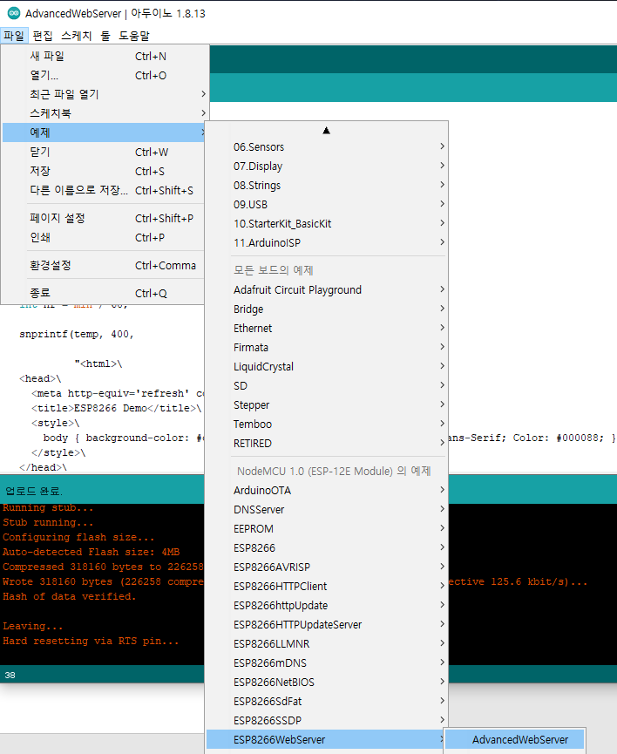
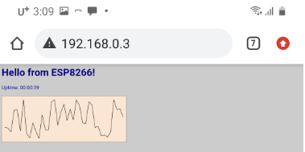
AdvancedWebServer 예제 실행결과(크롬 앱)

Slide 12
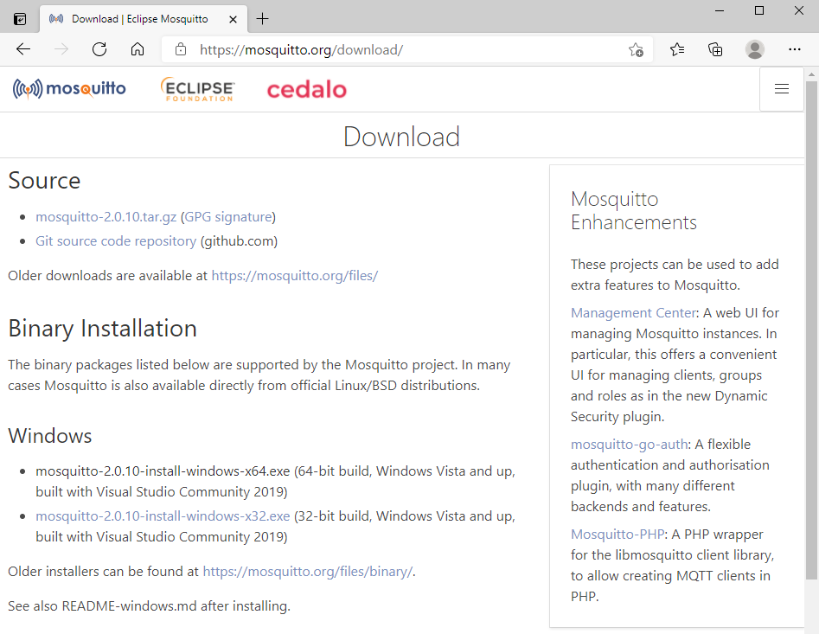
mosquitto 다운로드 사이트
설치 및 실행

Slide 13
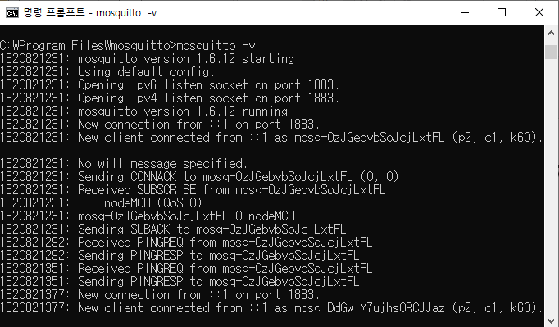
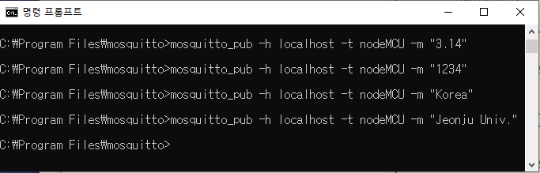
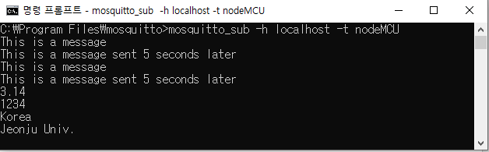
mosquitto 실행, 발행과 구독 실행화면
실행화면
발생(publish) 화면
구독(subscribe) 화면

Slide 14
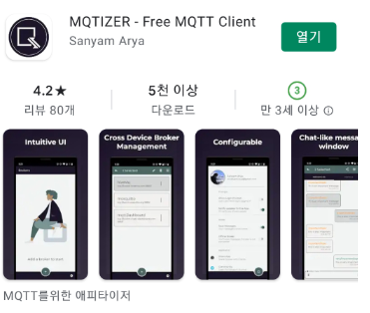
mqtt client 앱

Slide 15
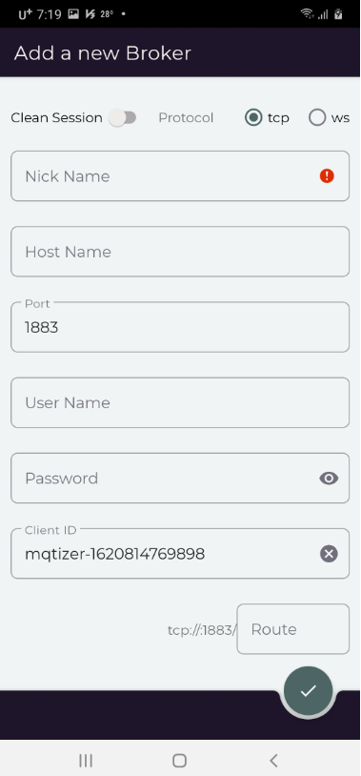
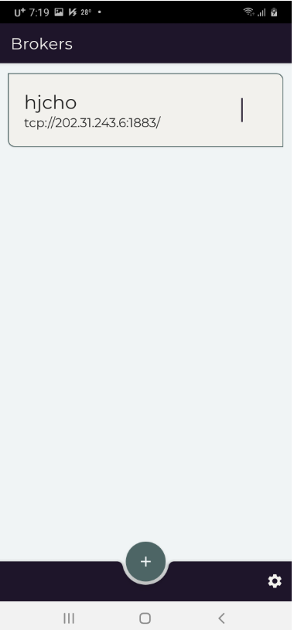
연결 Brokers 설정

Slide 16
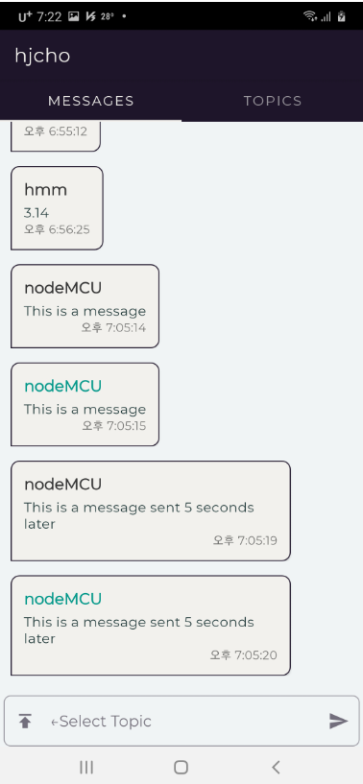
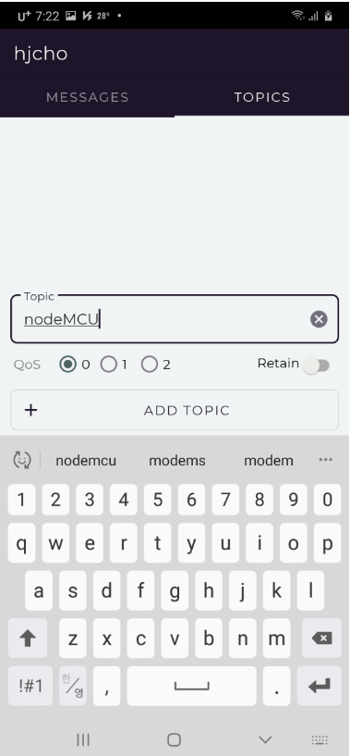
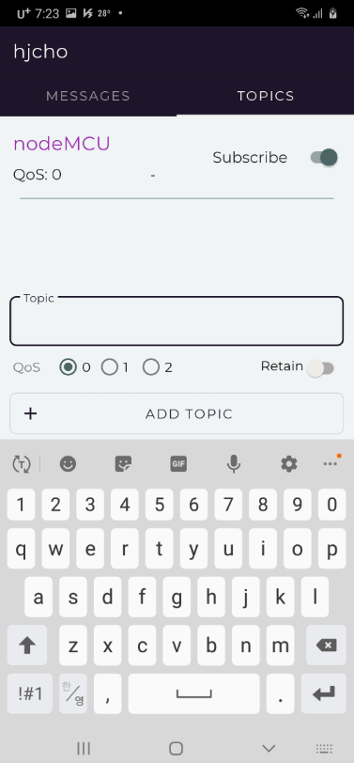
메시지 화면과 토픽화면

Slide 17
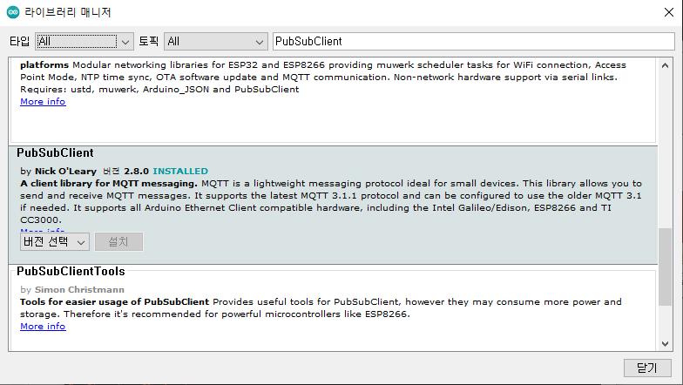
PubSubClient 라이브러리 설치
아두이노의 프로그램에서 툴 메뉴 > 라이브러리 관리

Slide 18
Mqtt-esp8266 예제 (1)
void setup_wifi() {
delay(10);
// We start by connecting to a WiFi network
Serial.println();
Serial.print("Connecting to ");
Serial.println(ssid);
WiFi.mode(WIFI_STA);
WiFi.begin(ssid, password);
while (WiFi.status() != WL_CONNECTED) {
delay(500);
Serial.print(".");
}
randomSeed(micros());
Serial.println("");
Serial.println("WiFi connected");
Serial.println("IP address: ");
Serial.println(WiFi.localIP());
}
#include <ESP8266WiFi.h>
#include <PubSubClient.h>
// Update these with values suitable for your network.
const char* ssid = "........";
const char* password = "........";
const char* mqtt_server = "broker.mqtt-dashboard.com";
WiFiClient espClient;
PubSubClient client(espClient);
unsigned long lastMsg = 0;
#define MSG_BUFFER_SIZE (50)
char msg[MSG_BUFFER_SIZE];
int value = 0;

Slide 19
Mqtt-esp8266 예제 (2)
void reconnect() {
// Loop until we're reconnected
while (!client.connected()) {
Serial.print("Attempting MQTT connection...");
// Create a random client ID
String clientId = "ESP8266Client-";
clientId += String(random(0xffff), HEX);
// Attempt to connect
if (client.connect(clientId.c_str())) {
Serial.println("connected");
// Once connected, publish an announcement...
client.publish("outTopic", "hello world");
// ... and resubscribe
client.subscribe("inTopic");
} else {
Serial.print("failed, rc=");
Serial.print(client.state());
Serial.println(" try again in 5 seconds");
// Wait 5 seconds before retrying
delay(5000);
}
}
}
void callback(char* topic, byte* payload, unsigned int length) {
Serial.print("Message arrived [");
Serial.print(topic);
Serial.print("] ");
for (int i = 0; i < length; i++) {
Serial.print((char)payload[i]);
}
Serial.println();
// Switch on the LED if an 1 was received as first character
if ((char)payload[0] == '1') {
digitalWrite(BUILTIN_LED, LOW); // Turn the LED on (Note that LOW is the voltage level
// but actually the LED is on; this is because
// it is active low on the ESP-01)
} else {
digitalWrite(BUILTIN_LED, HIGH); // Turn the LED off by making the voltage HIGH
}
}

Slide 20
Mqtt-esp8266 예제 (3)
void setup() {
pinMode(BUILTIN_LED, OUTPUT); /* Initialize the BUILTIN_LED pin as an output */
Serial.begin(115200);
setup_wifi();
client.setServer(mqtt_server, 1883);
client.setCallback(callback);
}
void loop() {
if (!client.connected()) {
reconnect();
}
client.loop();
unsigned long now = millis();
if (now - lastMsg > 2000) {
lastMsg = now;
++value;
snprintf (msg, MSG_BUFFER_SIZE, "hello world #%ld", value);
Serial.print("Publish message: ");
Serial.println(msg);
client.publish("outTopic", msg);
}
}

Slide 21
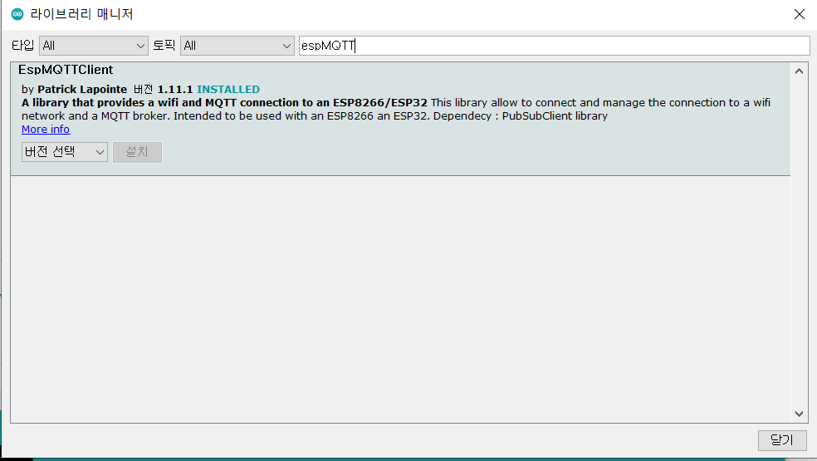
EspMQTTClient 라이브러리 추가

Slide 22
SimpleMQTTClient 예제(1)
// Optionnal functionnalities of EspMQTTClient :
client.enableDebuggingMessages(); // Enable debugging messages sent to serial output
client.enableHTTPWebUpdater(); // Enable the web updater. User and password default to values of MQTTUsername and MQTTPassword. These can be overrited with enableHTTPWebUpdater("user", "password").
client.enableLastWillMessage("TestClient/lastwill", "I am going offline"); // You can activate the retain flag by setting the third parameter to true
}
// This function is called once everything is connected (Wifi and MQTT)
// WARNING : YOU MUST IMPLEMENT IT IF YOU USE EspMQTTClient
void onConnectionEstablished()
{
// Subscribe to "mytopic/test" and display received message to Serial
client.subscribe("nodeMCU", [](const String & payload) {
Serial.println(payload);
});
#include "EspMQTTClient.h"
EspMQTTClient client(
“*******",
“**********",
"202.31.243.6", // MQTT Broker server ip
"MQTTUsername", // Can be omitted if not needed
"MQTTPassword", // Can be omitted if not needed
"hjcho", // Client name that uniquely identify your device
1883 // The MQTT port, default to 1883. this line can be omitted
);
void setup()
{
Serial.begin(115200);

Slide 23
SimpleMQTTClient 예제(2)
// Subscribe to "mytopic/wildcardtest/#" and display received message to Serial
client.subscribe("nodeMCU", [](const String & topic, const String & payload) {
Serial.println("(From wildcard) topic: " + topic + ", payload: " + payload);
});
// Publish a message to "mytopic/test"
client.publish("nodeMCU", "This is a message"); // You can activate the retain flag by setting the third parameter to true
// Execute delayed instructions
client.executeDelayed(5 * 1000, []() {
client.publish("nodeMCU", "This is a message sent 5 seconds later");
});
}
void loop()
{
client.loop();
}

Slide 24
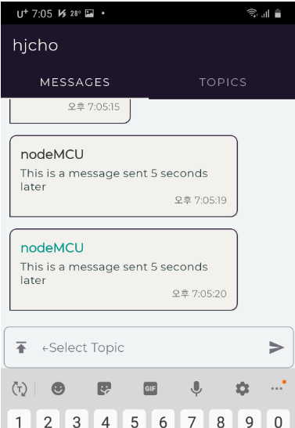
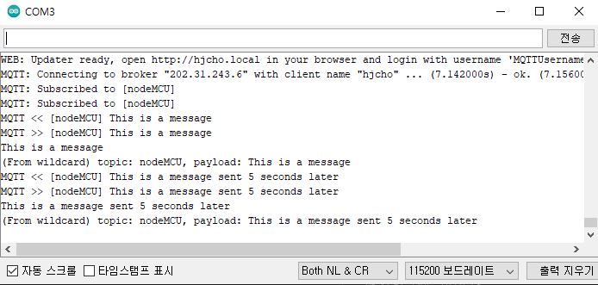
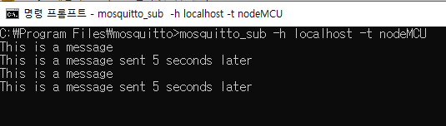
mosquitto(mqtt broker) 실행결과

Slide 25

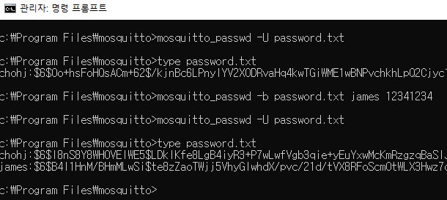
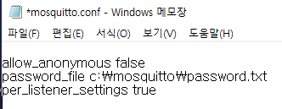
Mosquitto ID, Password 설정
1. ID, Password 등록파일 생성
1) password.txt 파일을 생성하여 id:password 형식으로 작성
2) password.txt 파일을 Mosquitto가 설치된 폴더로 이동
2. mosquitto가 설치된 폴더로 이동 및 암호화
1) C:\mosquitto>mosquitto_passwd –U password.txt
2) Password 암호화 확인
3) user password 추가
mosquitto_passwd -b passwordfile user password
3. mosquitto.conf 설정
1) Security
allow_anonymous false (true이면 아무나 브로커에 접근가능)
2) Default authentication and topic access control
password_file password.txt (mosquitto_passwd 유틸리티로 생성)

Slide 26
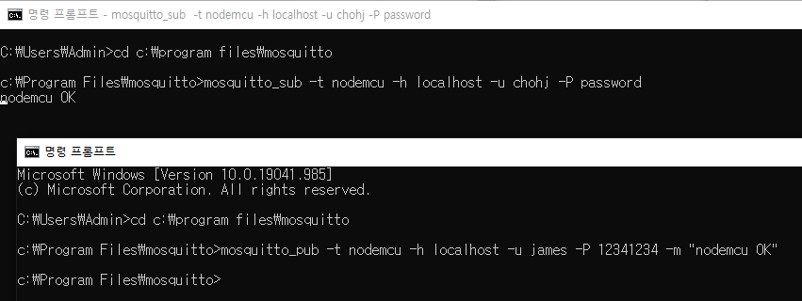
Mqtt 브로커 ID,passwd 사용한 실행결과
mosquitto.conf나 password.txt 수정 시엔 mqtt broker 를 다시 실행하야 함.

